Slide 1
Musculoskeletal system

Slide 2
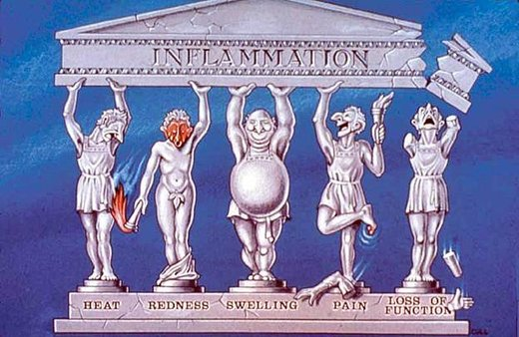
Cоlor Rubor Tumor Dolor Functio laesa

Slide 3
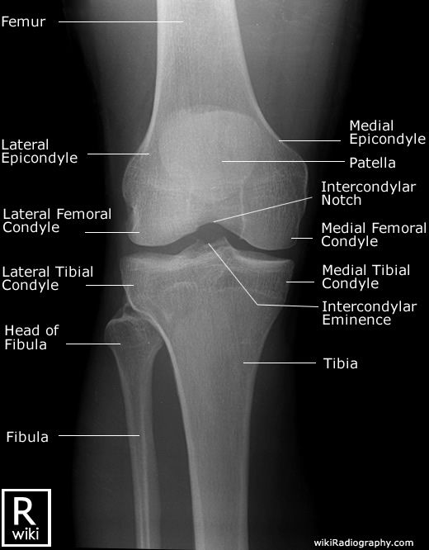
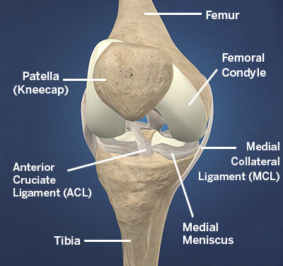

Slide 4
Main complaints
Pain
Stiffness
Swelling
Erythema (Redness) and warmth
Weakness
Locking and triggering

Slide 5
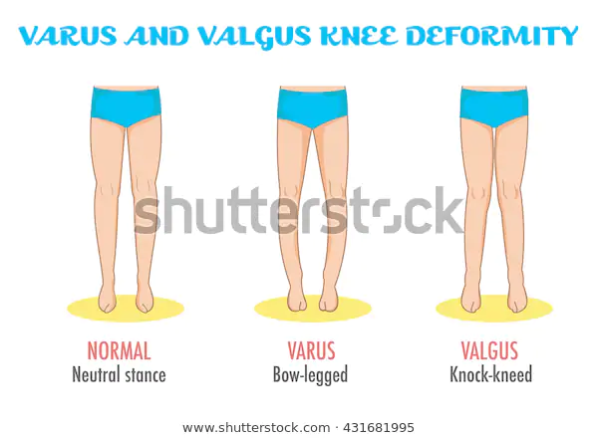

Slide 6
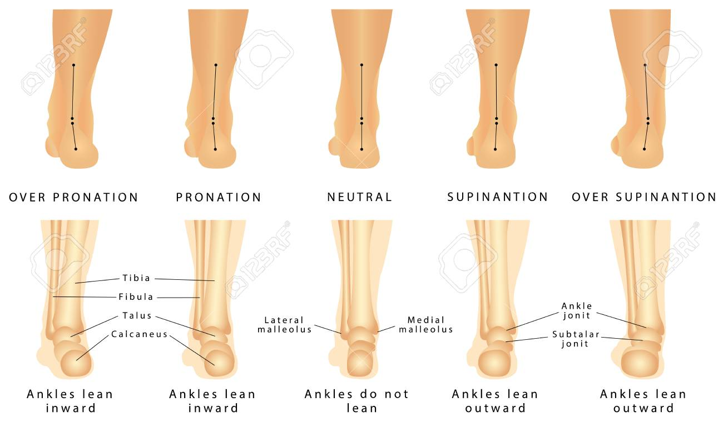
Varus and valgus deformation

Slide 7
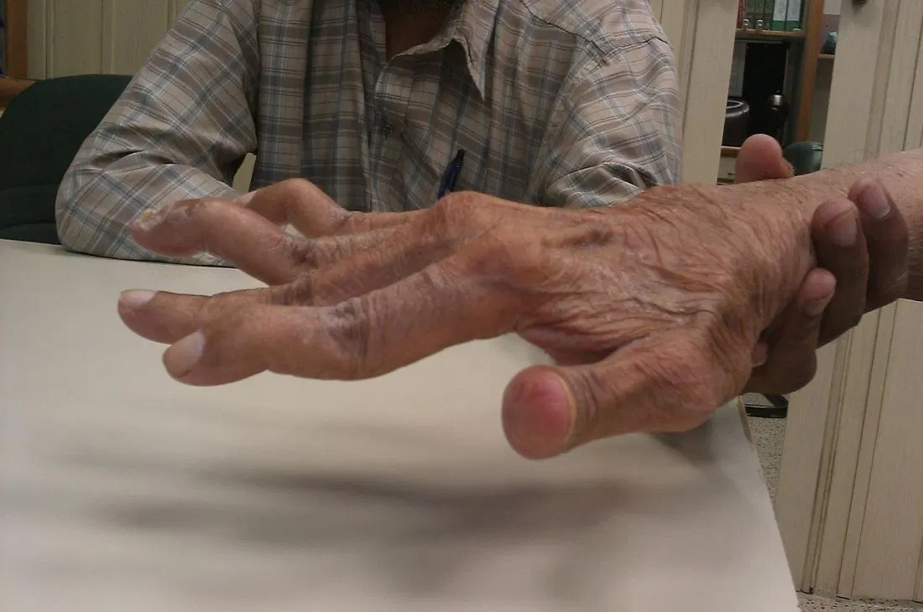
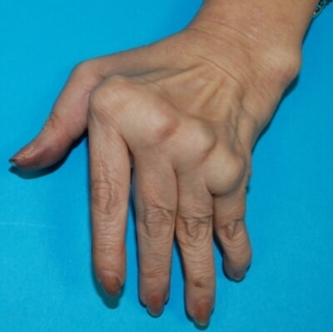
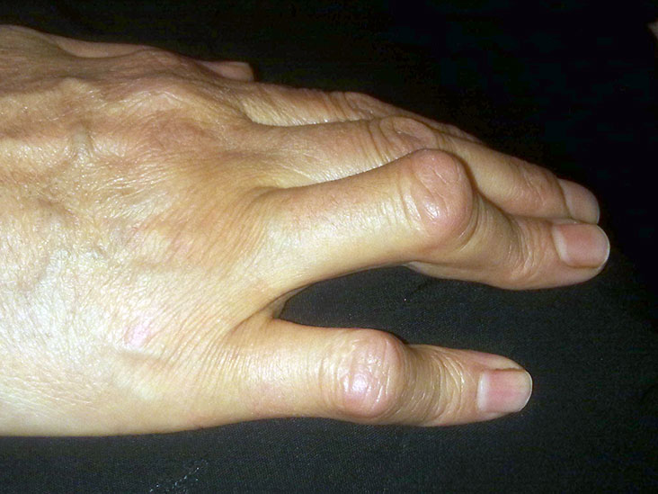
Joints deformity

Slide 8
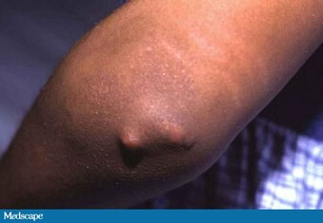
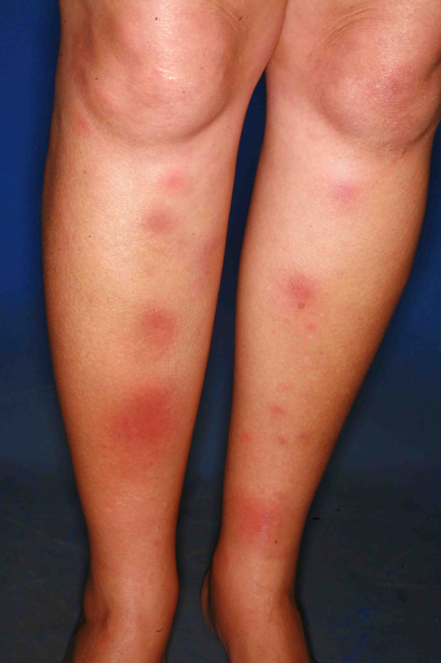
Rheumatic nodes and Erythema nodosum

Slide 9
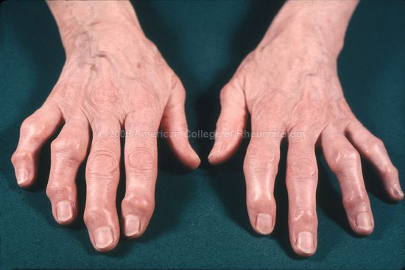
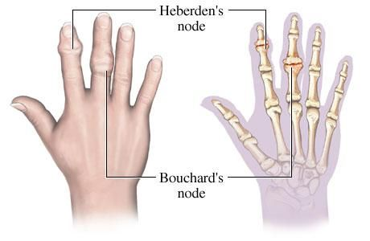
Heberden’ and Bouchard’ nodes https://stanfordmedicine25.stanford.edu/the25/hand.html

Slide 10
Please give relevant examples of diseases
Monoarthritis
Oligoarthritis
Polyarthritis
Spondyloarthritis
Spondylitis
Sacroileitis

Slide 11
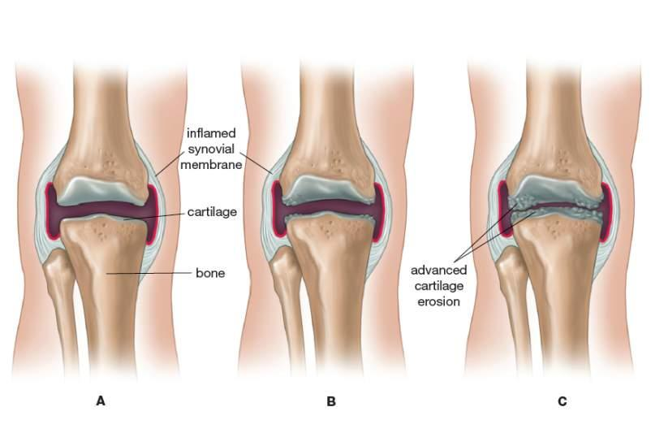
Arthritis

Slide 12
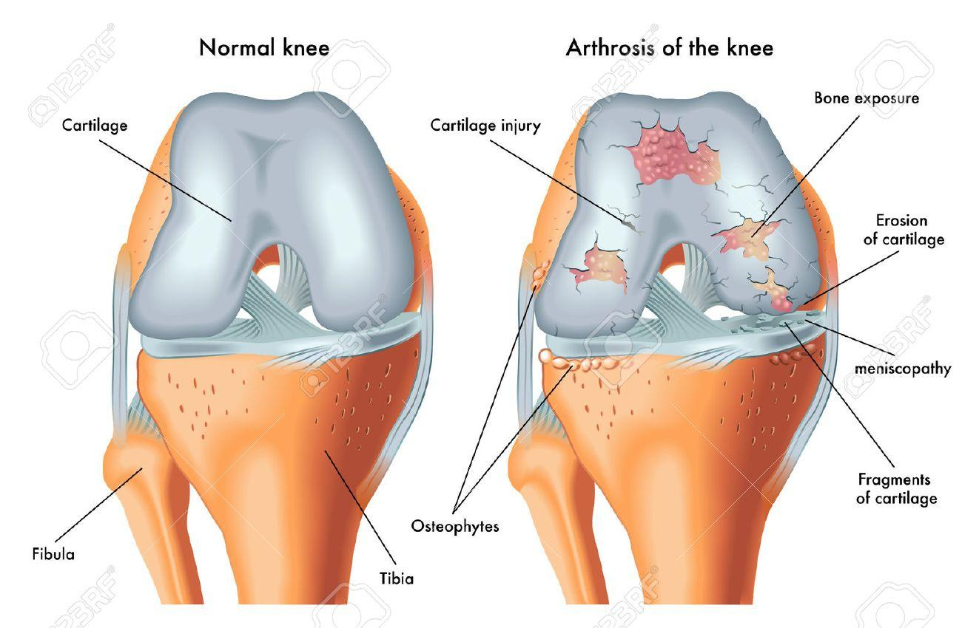
Arthrosis

Slide 13
task
Please name and write differences between chronic arthritis and arthrosis
Complaints
History
Physical examination: observation, palpation, joints mobility
X-ray diagnostic

Slide 14
arthritis versus arthrosis - complaints
Complaints | Arthritis | Osteoarthritis (Octeoarthrosis)
Pain (Artralgia) | Irritation of the receptors of the joint capsule, ligaments and tendons due to: 1) inflammation of the joint capsule with the activation of biologically active substances, 2) stretching the capsule exudate, 3) reflex spasm of the periarticular muscles | 1) Destruction of the articular cartilage with exposure of the subchondral bone and a decrease in the ability of the articular surfaces to withstand the load leads to increased pressure on the bone, deflection of the beams towards the spongy bone and their micro-fractures. 2) Fibrosis of the capsule compresses the nerve endings, sprain of the affected ligaments (secondary periarthritis) during movement.
The nature and severity of pain | 1). Acute, intense pain with limited physical activity 2). Very strong, tearing pain, aggravated by touching the affected joint (e.g. gout, purulent arthritis) | Dull, aching, moderate. “Mechanical” type of pain - pain occurs with a functional load on the joint (walking) and disappears after the load is stopped. “Starting pain” - rubbing against each other of the articular surfaces on which particles of necrotic cartilage have settled. At the first steps, the cartilage detritus is pushed into the joint cavity and the pain ceases.
Localization of joint pain | Spilled, diffuse pain over the entire surface of the joint | Along the joint space
Daily rhythm of pain | The pain disturbs day and night, intensifying in the morning after a long period of immobilization. An attack of severe pain in the joint in the first half of the night after an error in the diet (e.g. gout). | The pain occurs in the morning with the first movements and intensifies by the end of the day and the first half of the night
Primary lesion of certain joints and groups of joints | 1). Symmetric damage of the small joints of the hands and feet (e.g. RA) 2). Simultaneous Damage to the Shoulder and Hip Joints (e.g. Ankylosing Spondylitis) 3). Unilateral damage to the joints of one limb (axial lesion) e.g. Reuter’s syndrome | Large joints of the legs (knee, hip).
Stiffness | - a non-painful feeling of difficulty at the beginning of movement after a long period of immobility (e.g. total morning stiffness for more than 30 minutes in RA)

Slide 15
arthritis versus arthrosis - Examination
 | Arthritis | Osteoarthritis (Octeoarthrosis)
Position | Unloading posture (flexion) in acute arthitis | Axis offset
The form | Spherical. Deformation - a gross violation of the shape of the joint with subluxation, dislocation of the joint, ankylosis with arthritis | Deformation - a gross violation of the shape of the joint with subluxation, dislocation of the joint, ankylosis with arthritis
Outlines (shape) | Smoothness in acute arthritis
Special types of configuration | “Walrus fin“ (ulnar deviation). “Swan Neck”. “boutonniere deformity "button loop" | Hallux valgus Heberden’ and Bouchard’ nodes
Skin over the joint | Tense, shiny. Hyperemia.
Periarticular muscles | Atrophy of the muscles of the extensor joints in chronic arthritis. Atrophy of tenar, hypotenar, interosseous muscles of the rear of the hands in RA

Slide 16
arthritis versus arthrosis - palpation
 | Arthritis | Osteoarthritis (Octeoarthrosis)
Palpation pain | Diffuse pain in all parts of the joint with arthritis.
Degree of pain | Intense pain - with purulent, microcrystalline arthritis (including gout). Significant pain - with reactive, rheumatoid arthritis, shoulder-scapular periarthritis. Mild pain - with inflammation of periarticular tissues
Mobility |  | Restriction of active and passive movements in all directions
Joint noises |  | Cracking in the joint - coarse crepitus, audible from a distance

Slide 17
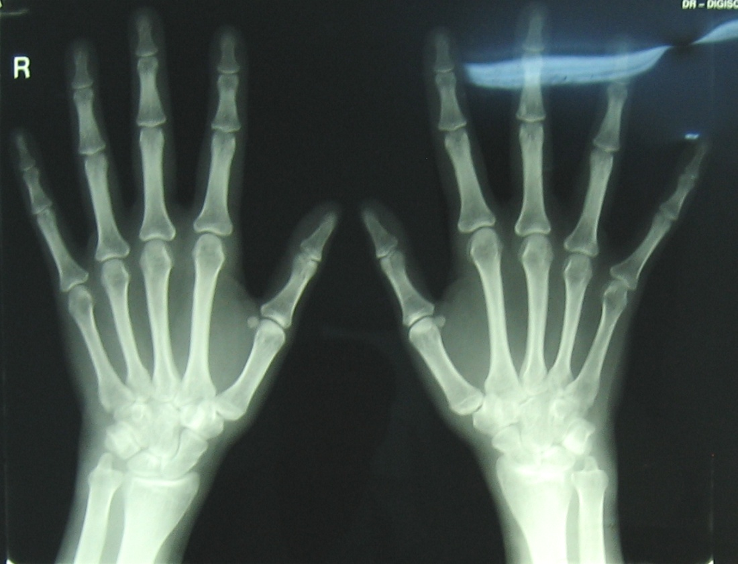
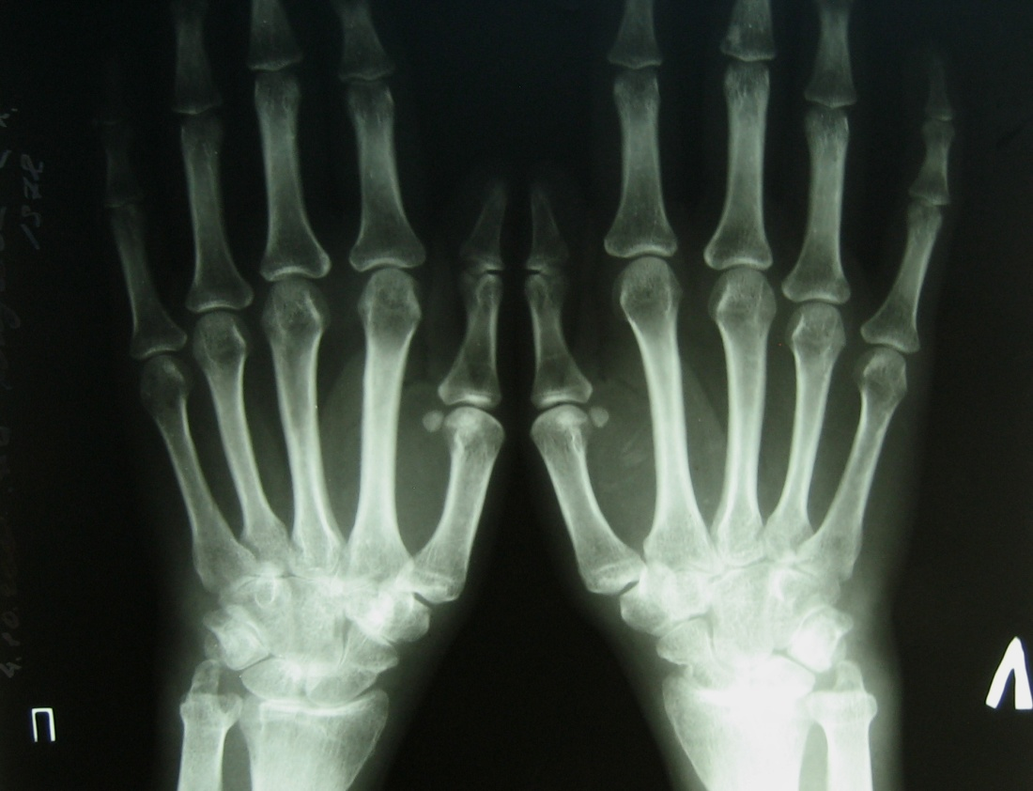
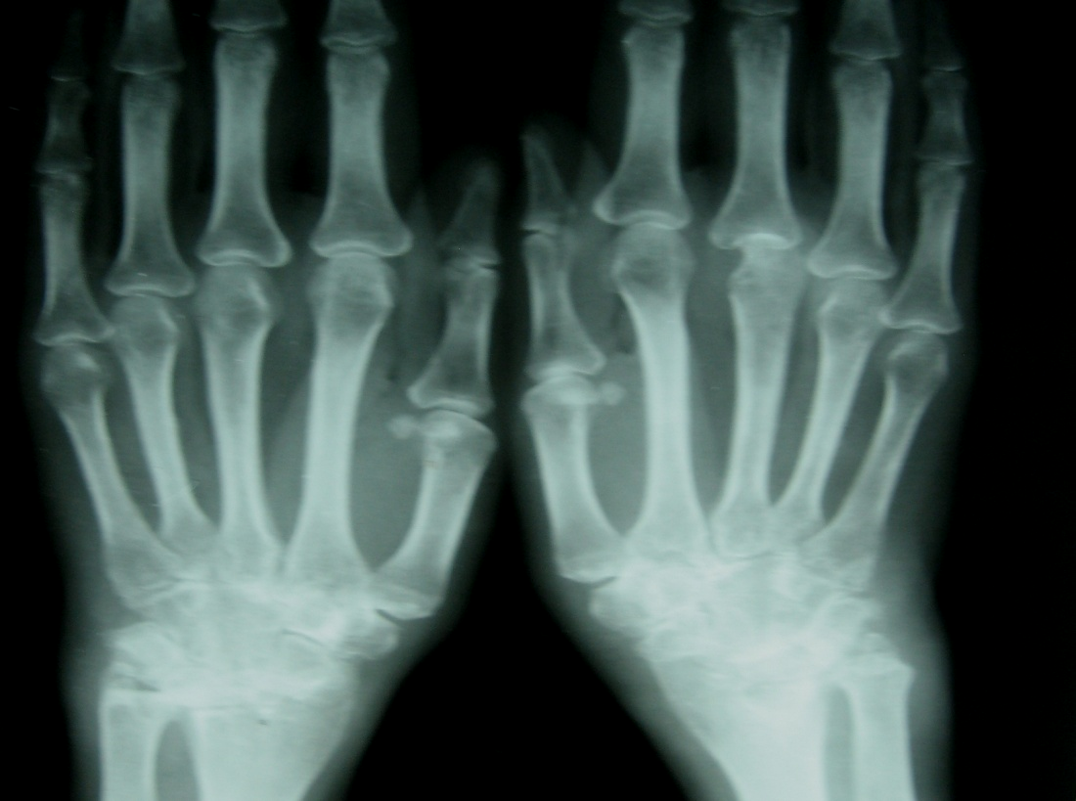
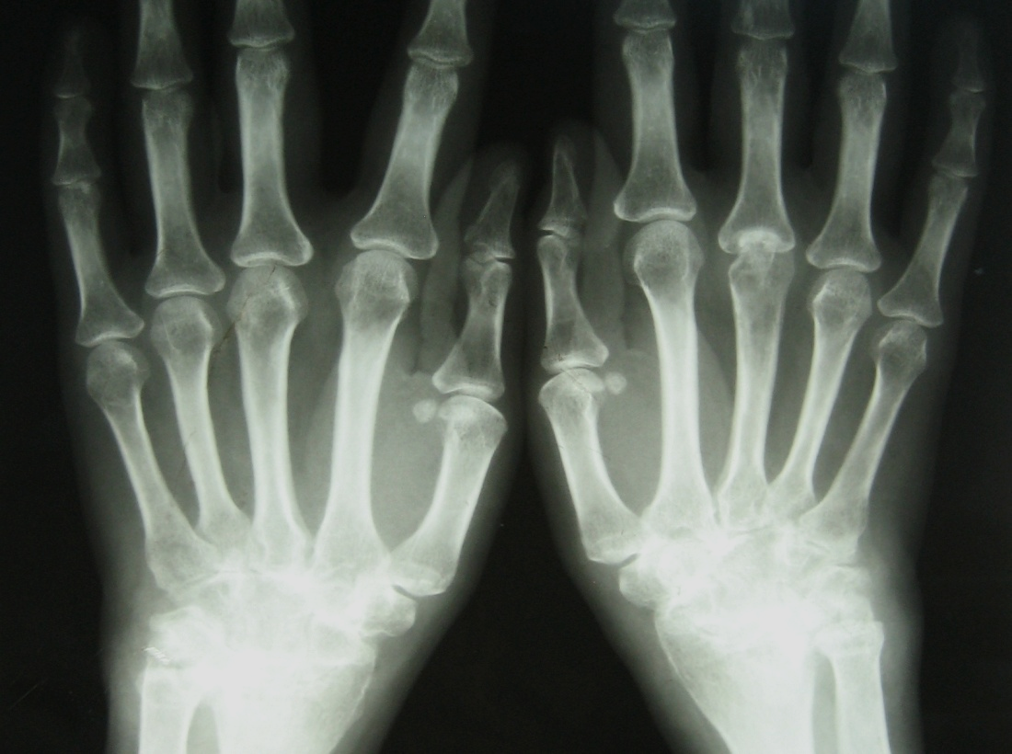
Пример больного с ревматоидным артритом
1 год
2 год
3 год
4 год
Notes:
Юнусова
2000 2001
2004 2007

Slide 18
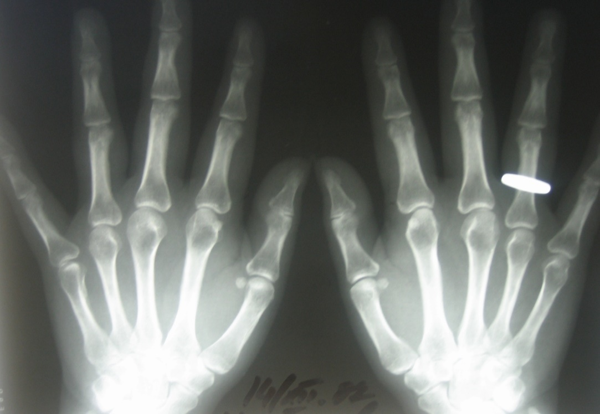
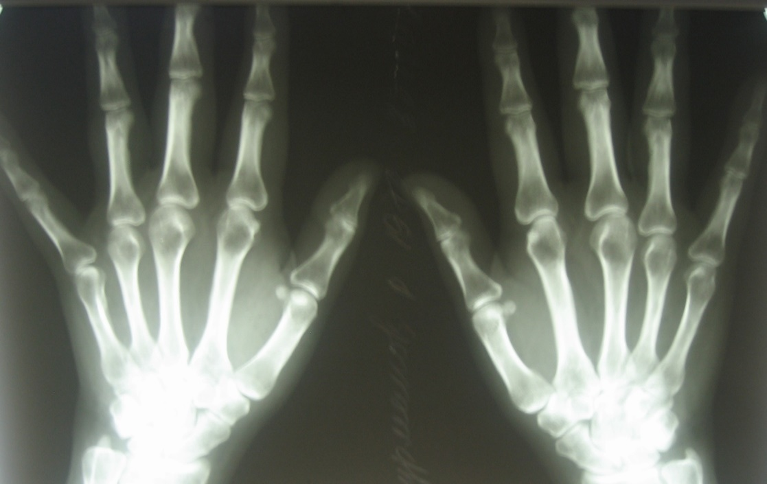
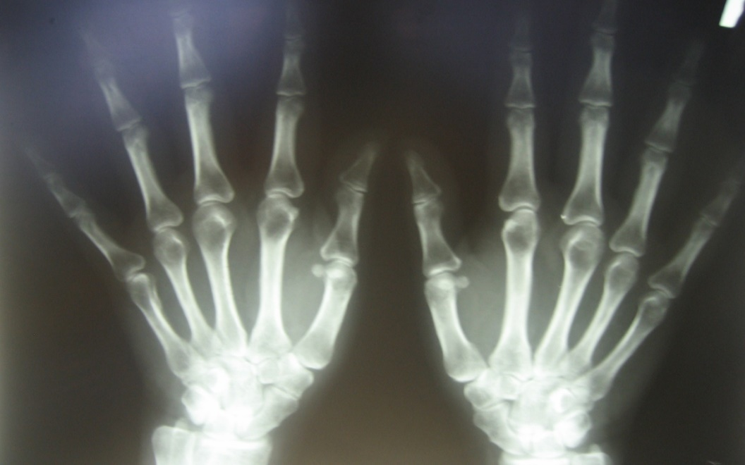
Пример больного с бруцеллезом
1 год
3 год
4 год
Notes:
Нурманова
2007 2008
2009

Slide 19
Gait pathological gait
https://stanfordmedicine25.stanford.edu/the25/gait.html
https://www.youtube.com/watch?v=g4LBfrDicnA
Goose gait is typical to:
Damages of both knee joints
Damages of both hip joints
Lumbar spine damage
Damage of one ankle joint
Damage of one hip joint

Slide 20
Gait pathological gait
Goose gait is typical to:
Damages of both knee joints
Damages of both hip joints
Lumbar spine damage
Damage of one ankle joint
Damage of one hip joint

Slide 21
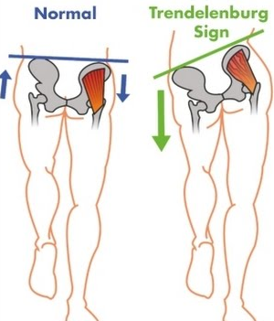
Trendelenburg sign
- Superior Gluteal nerve injury
- Gluteus medius and minimus weakness

Slide 22
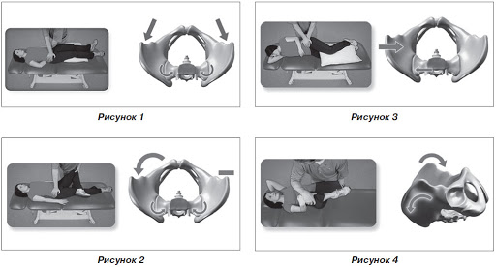
Kushilevsky tests for sacroileitis

Slide 23
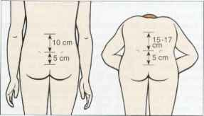
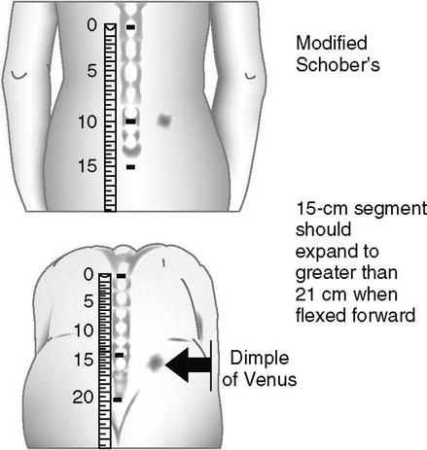
Schober’ test

Slide 24
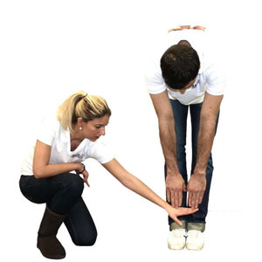
Thomayer’ test

Slide 25
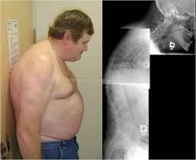
Forestier test

Slide 26
